Slide 1
Outcome 9: Photosynthesis
Looks at process of photosynthesis overall, Light dependent reactions and Calvin cycle.
Directions: move each box to the correct location on the diagram.

Slide 2
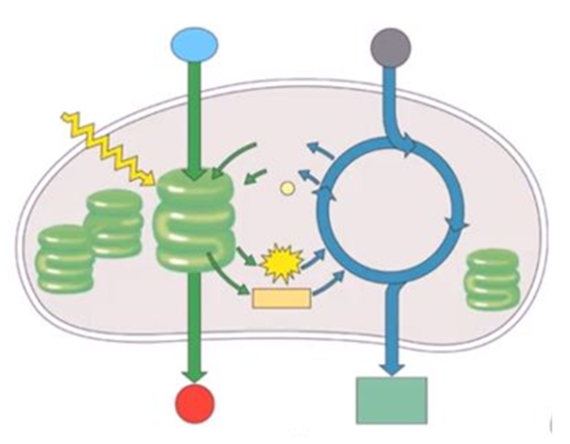
Oxygen is released
H2O enters and is split into oxygen and H+ ions.
Thylakoid
Sunlight enters exciting electrons.
Stroma
ATP is created using energy from H+ ions moving through the membrane causing a phosphate to attach to ADP.
NADP+ remains after energy is used.
Step 1 = light- dependent reactions
CO2 enters to combine with carbon and make glucose with the use of NADPH & ATP.
NADPH is created by NADP+ carrying excited electrons and a H+ ion.
Step 2 = Calvin cycle
ADP remains after energy is used.
Glucose is produced
Chloroplast

Slide 3
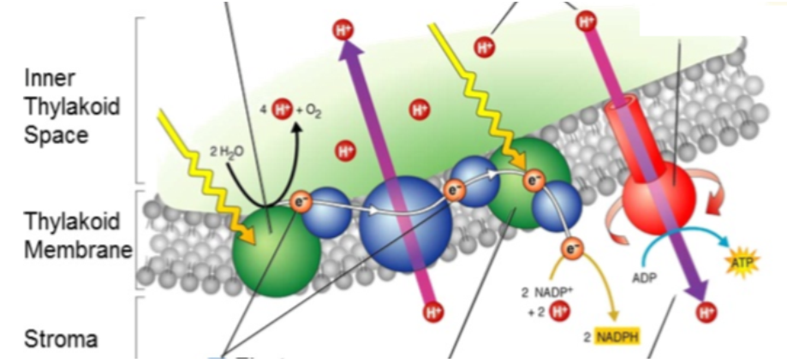
Light Dependent Reaction Structures:
Photosystem I
H+ ions - create concentration gradient
Photosystem II – contains chlorophyl that absorbs photos to excite electrons.
ATP Synthase – protein for H+ ions travels through
ETC (electron transport chain) – carries excited electrons

Slide 4
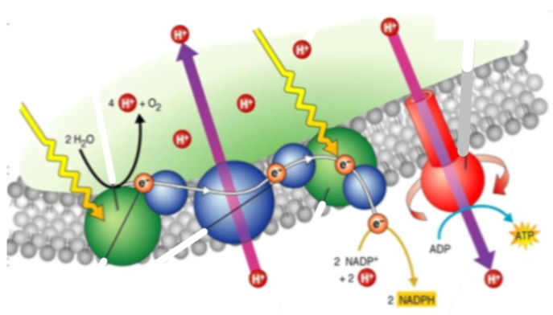
Light Dependent Reaction Process:
Once at the end of the ETC the sun’s energy excites the electrons again and this energy is carried by NADP+ to go to the CC.
C.
Water enters and is separated by enzymes creating oxygen and more H+ ions affecting the concentration gradient.
E.
B.
H+ ions move from a + to – gradient across ATP synthase. When this occurs energy is made which is used to attach a phosphoryl group to ADP making ATP to go to the CC.
A.
D.
Sunlight enters as photons and excites electrons found in chlorophyll.
The excited electrons move along the ETC causing H+ ions to move from outside the thylakoid membrane to inside.

Slide 5
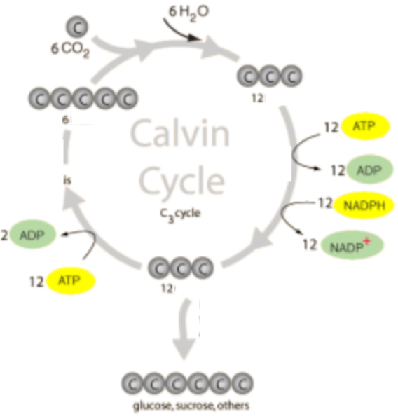
Calvin Cycle Process:
2 3-carbon molecules are removed to make glucose.
A.
The ATP and NADPH created in the LDR are used to move carbon molecules around making new carbon structures.
D.
B.
ATP is used to arrange the leftover carbon into 5-carbon molecules that remain in the cycle.
C.
CO2 is combined with an already existing 5-carbon molecule making 12 3-carbon molecules.

Slide 6
ANSWERS

Slide 7
Answer:
ADP remains after energy is used.
H2O enters and is split into oxygen and H+ ions.
Sunlight enters exciting electrons.
CO2 enters to combine with carbon and make glucose with the use of NADPH & ATP.
NADP+ remains after energy is used.
Step 1 = light- dependent reactions
Step 2 = Calvin cycle
Thylakoid
Stroma
Chloroplast
NADPH is created by NADP+ carrying excited electrons and a H+ ion.
ATP is created using energy from H+ ions moving through the membrane causing a phosphate to attach to ADP.
Glucose is produced
Oxygen is released

Slide 8
ANSWER:
H+ ions - create concentration gradient
Photosystem II – contains chlorophyl that absorbs photos to excite electrons.
ATP Synthase – protein for H+ ions travels through
ETC (electron transport chain) – carries excited electrons
Photosystem I

Slide 9
ANSWER:
The excited electrons move along the ETC causing H+ ions to move from outside the thylakoid membrane to inside.
H+ ions move from a + to – gradient across ATP synthase. When this occurs energy is made which is used to attach a phosphoryl group to ADP making ATP to go to the CC.
C.
Water enters and is separated by enzymes creating oxygen and more H+ ions affecting the concentration gradient.
E.
B.
A.
D.
Sunlight enters as photons and excites electrons found in chlorophyll.
Once at the end of the ETC the sun’s energy excites the electrons again and this energy is carried by NADP+ to go to the CC.

Slide 10
ANSWER:
A.
CO2 is combined with an already existing 5-carbon molecule making 12 3-carbon molecules.
The ATP and NADPH created in the LDR are used to move carbon molecules around making new carbon structures.
ATP is used to arrange the leftover carbon into 5-carbon molecules that remain in the cycle.
D.
B.
C.
2 3-carbon molecules are removed to make glucose.

