Slide 1
nose
mouth
pharnyx
epiglottis
larnyx
trachea
bronchus
lung
bronchioles
diaphragm
alevoli

Slide 2
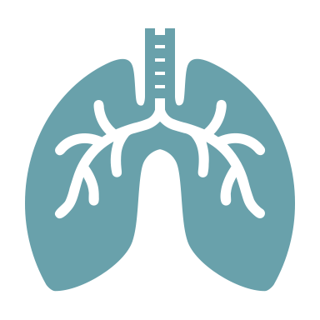
Breathing & the diaphragm
Outcome 22 – The Respiratory System

Slide 3
What is Breathing?
Breathing and respiration are related, but they are not the same
Respiration – the release of energy by combining oxygen with digested food (glucose)
Breathing – taking air into the lungs and forcing the air out of the lungs
The lungs are the organs involved with breathing
→ main organ of the respiratory system
Breathing happens automatically by the actions of the lungs

Slide 4
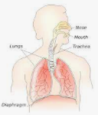
The Diaphragm
Your chest size changes when you breathe because of the:
Actions of your rib muscles
Actions of your diaphragm muscle
Diaphragm – a large flat muscle at the base of the lungs that aids in breathing
Fun fact: does anyone know what your rib muscles are called?

Slide 5
Feedback Loop of Breathing
The amount of carbon dioxide in your blood INCREASES to a certain level . . .
Your brain sends a message to your diaphragm and rib muscles to INCREASE the size of your chest cavity . . .
The INCREASE is sensed by a receptor in your body . . .
This causes more air to move into the lungs, DECREASING the amount of carbon dioxide in your blood
A message is sent to your brain . . .
STIMULUS
RECEPTOR
CONTROL CENTER
EFFECTOR
Task: Identify the parts of this feedback loop.
RESPONSE

Slide 6
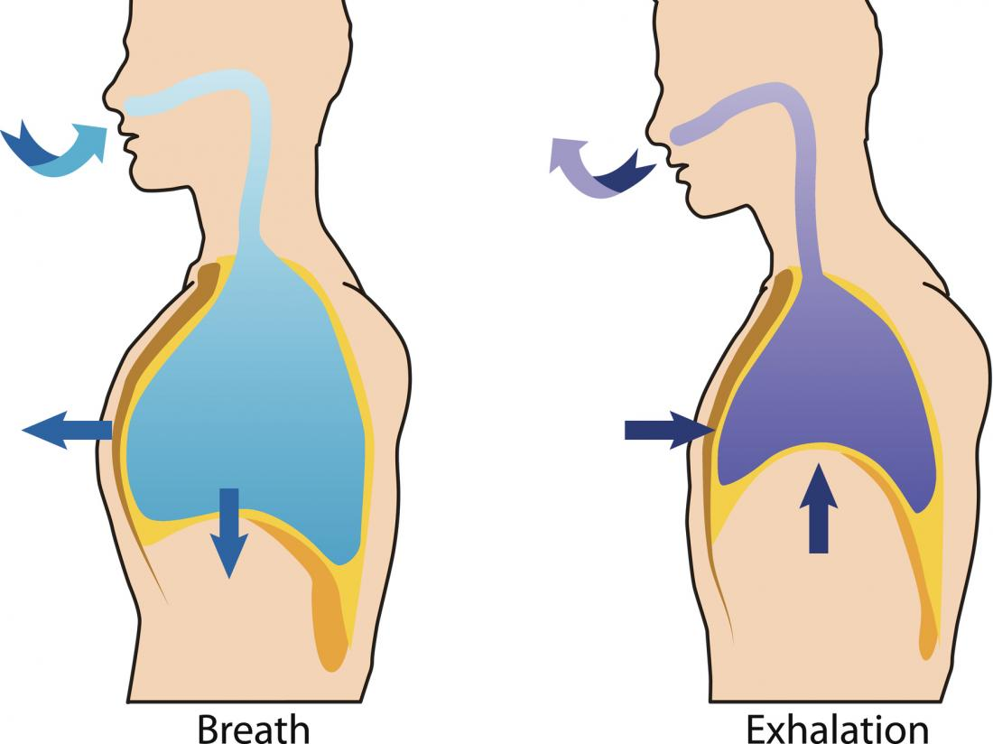
Mechanics of Breathing
It is the moving of your chest that makes your lungs expand and contract
Breathing IN
Chest cavity moves OUT
Diaphragm moves DOWN
Breathing OUT
Chest cavity moves IN
Diaphragm moves UP

Slide 7
Boyle’s Law - INHALE
Breathing IN
Chest cavity moves OUT
Diaphragm moves DOWN
INCREASES volume of chest cavity
DECREASES pressure in the chest cavity
Allows air to rush INTO the lungs

Slide 8
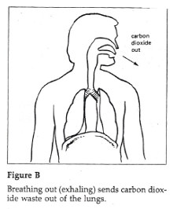
Boyle’s Law - EXHALE
Breathing OUT
Chest cavity moves IN
Diaphragm moves UP
DECREASES volume of chest cavity
INCREASES pressure in the chest cavity
Air is forced OUT OF the lungs
Extension: why does pressure INCREASE when volume DECREASES?

