Slide 1
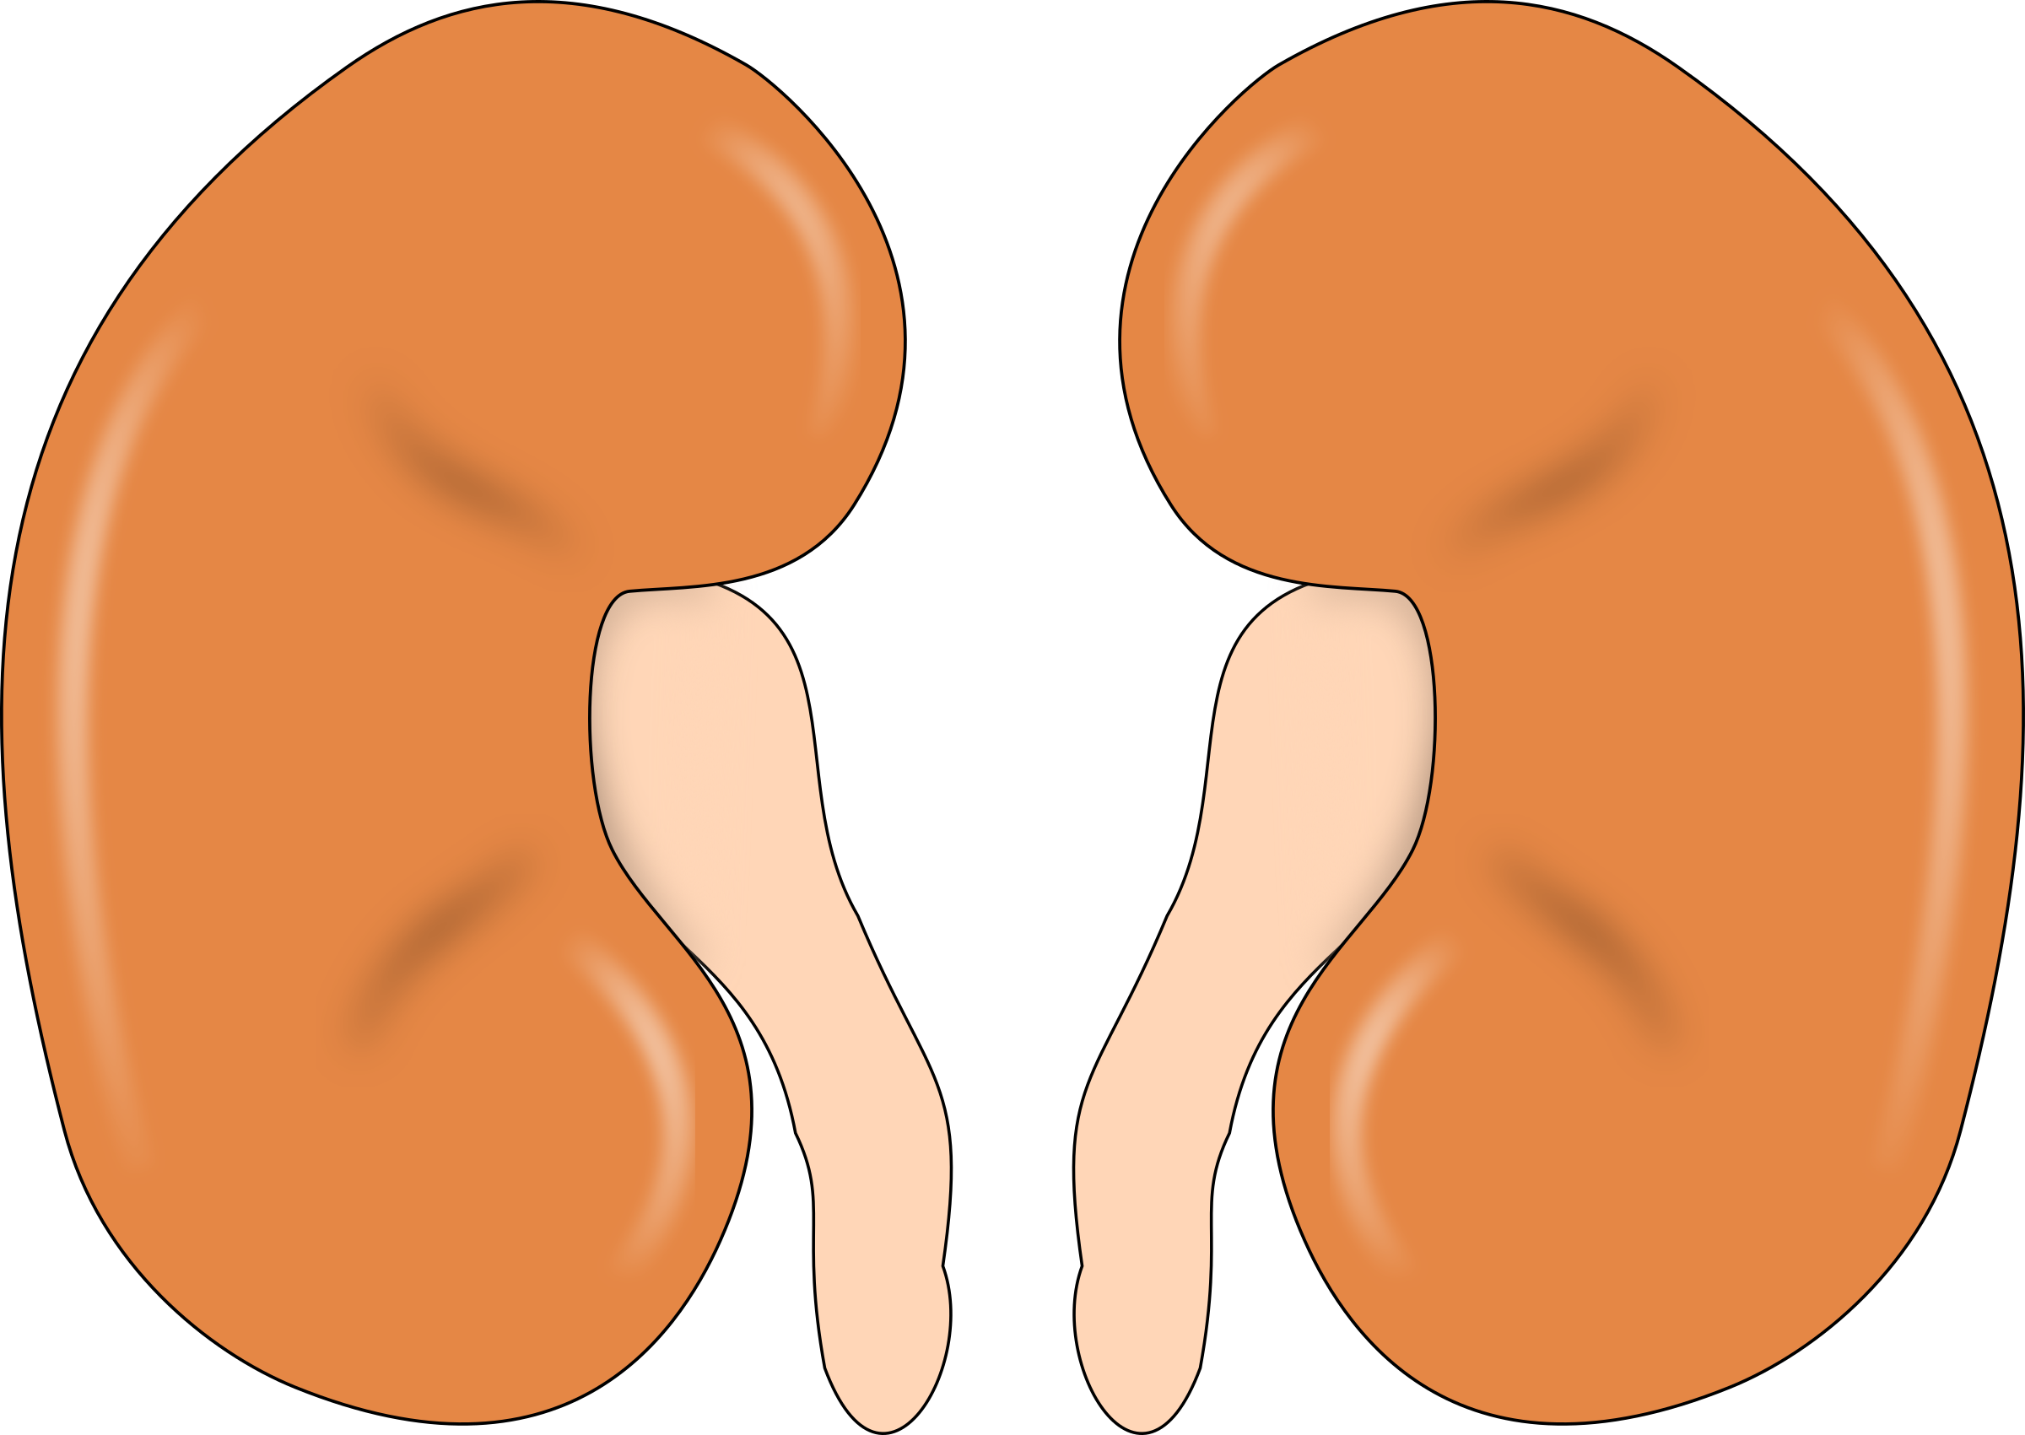
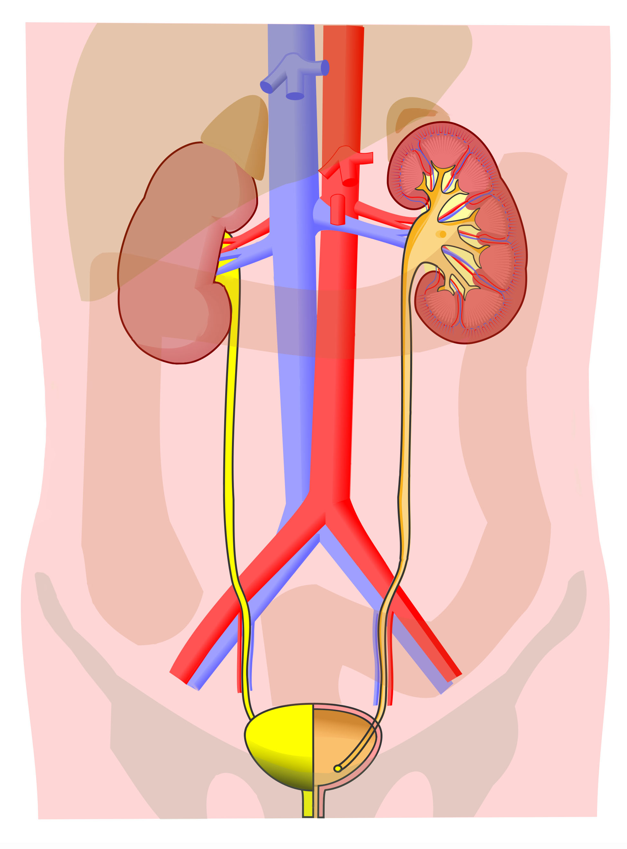
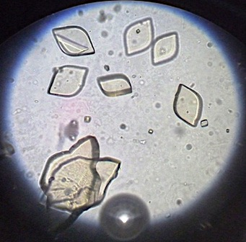
Name: ____________________________________________________ Date: ____________________________
EXCRETORY SYSTEM EXHIBITION LAB
Vanessa Jason Biology Roots
Station 1- Excretion
Excretion is the process of _________________________ _________________________________________________ from the body.
How is excretion crucial for homeostasis? ___________________________________________________
Station 2- The Kidneys
The main job of the kidneys is to ______________ _____________.
Secondary functions include maintaining correct __________ levels, salt and ______________ levels in the blood, and to produce _________________.
ORGANS INVOLVED | EXCRETION
SKIN
 | FECES
KIDNEYS
Vanessa Jason Biology Roots
Station 3- The Kidneys as a Filter
The kidneys are the __________ _____________ of the excretory system because they filter the ___________ from many substances.
How are the kidneys connected to your blood supply? _______________________________________________________________________
How are the kidneys like the lungs of the respiratory system?
_____________________________________________________________________________________________________________________
Vanessa Jason Biology Roots
Station 4- Diagram Label
Vena cava
Dorsal aorta
Station 5- What is filtered?
A ____________ product is a product of a chemical reaction that we cannot use.
Examples of waste filtered from the blood:
_________________________
_________________________
_________________________
_________________________
_________________________
_________________________
Healthy urine contains tiny solid particles sometimes called crystals. Examples include (name 3): _____________________ _____________________________________
© Biology Roots, LLC
Biology Roots, LLC
Vanessa Jason Biology Roots

Slide 2
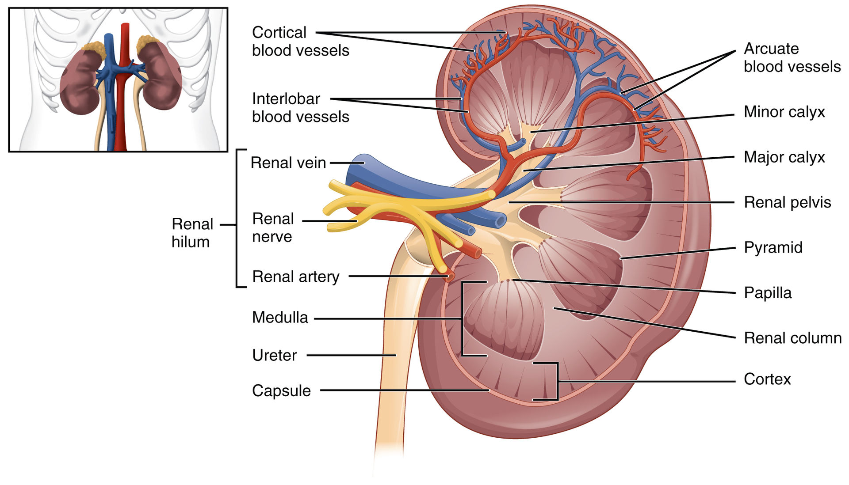
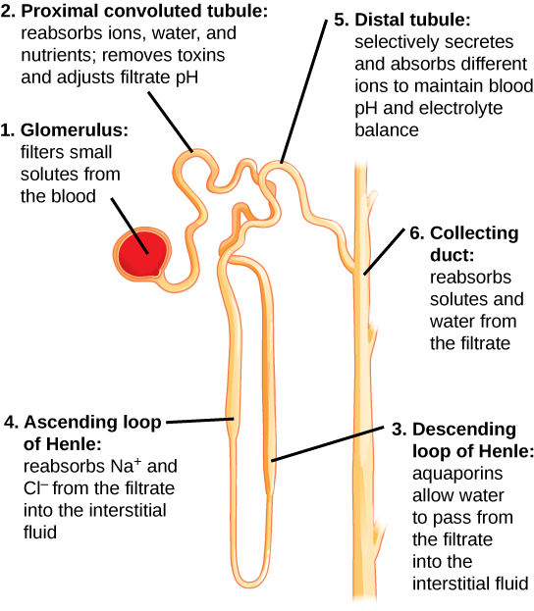
Station 6- Kidney Stones
How can kidney stones form? _________________________________________________________________________________________.
What are kidney stones usually made of? ____________________________________
Station 7- Kidney Anatomy
Kidneys are about the size of a ________________ _________ and located _______________________ __________________________________________.
Outer region= ______________________________
Inner region= ______________________________
Vanessa Jason Biology Roots
Station 8- Nephrons
Each kidney is made up of smaller filtering units called ________________.
The nephron filters the ______________ and produces ____________.
Each kidney has approximately ________________ nephrons.
Filtrate = liquid in the nephrons that is being filtered.
Interstitial fluid= fluid outside that leads to the blood vessels.
Vanessa Jason Biology Roots
Reabsorbs ____, _________ and
___________; removes _________ and adjusts filtrate ____.
Selectively __________ and _________ different ions to maintain _____________ and ________________ balance.
Vanessa Jason Biology Roots
Station 9- Urine
Use the pie chart below to determine which chunk is water and which chunk is solutes. Label accordingly. For the solutes, write down 6 or 7 of them in the space provided.
_________________________________________________________________________________________.
The stuff your urine is made of up can depend on what you’ve _________, __________/consumed, or ______________ through your ________.
Reabsorbs _____ and _____ from the _______ to the interstitial fluid.
Station 11- STEPS OF URINE FORMATION:
_____________________
________________________ (back to blood stream)
_________________________ (from blood stream into nephron).
Urine formation occurs in the ________________.
Station 10- Plasma, not blood cells.
Plasma is ________________ through the nephrons, blood cells are not because they are _______ ________ to fit through the filtration system. Red blood cells in the urine can be a sign of ____________________________________________.
© Biology Roots, LLC
Biology Roots, LLC
Vanessa Jason Biology Roots

Slide 3
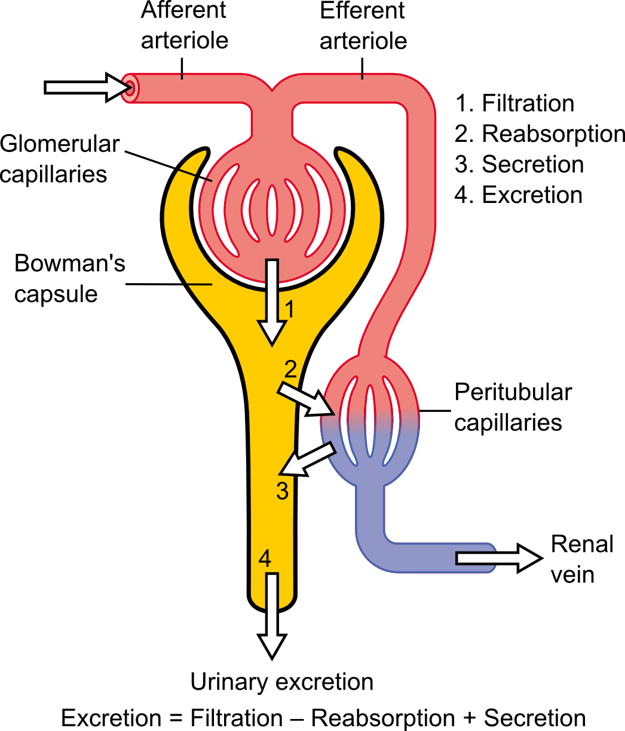
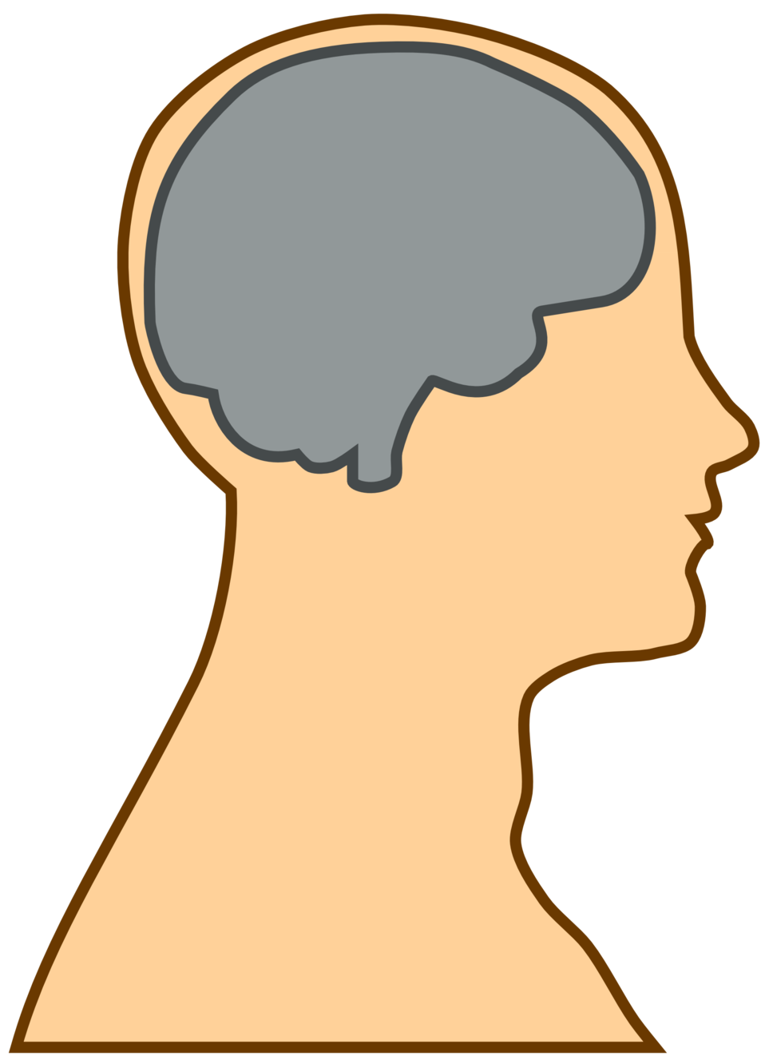
Station 12- FILTRATION
Most filtration occurs in the ________________. Naturally occurring blood ___________ forces __________ into the _____________ ____________. *Put a star in the area between the glomerulus and the Bowman’s capsule.
Vanessa Jason Biology Roots
Station 13- REABSORPTION
Nephrons → ___________________________.
Reabsorption is the process of returning __________, filtered plasma back to the ________________ system. The concentrated fluid that remains is _______________.
What else might be reabsorbed back into the blood? ____________________________________________________
What would happen if reabsorption did not occur? ____________________________________________________
Vanessa Jason Biology Roots
Station 14- SECRETION
Bloodstream → ____________________.
Secretion is the movement of materials into the nephrons and these may include ions, __________________, and _________.
Station 16- Relationship to Endocrine System (Homeostasis)
What is ADH and what does it do?______________________________________________________________________.
How is the relationship between the kidneys and the endocrine system important for homeostasis? ________________________________________________________________________________________________________.
Vanessa Jason Biology Roots
Station 15- Cell Transport within the kidneys
Nephrons rely on ____________ or ______________ _________ ________________ to filter the blood and form urine.
The passing of fluids and solutes occurs across the cell ______________ of the ___________________.
Materials are transported between the nephrons and the ______________ _______________ to help maintain ________________________.
Nephrons have very active _____________-________________ pumps!
Review the diagrams at this station.
What types of substances are being reabsorbed?
What types of substances are being secreted?
(If you are unsure of reabsorption vs. secretion, please come back after you have visited stations 13 and 14).
Station 17- CELL TRANSPORT and HOMEOSTASIS
Read the station and provide an example of how cell transport assists in homeostasis. _______________________ _____________________________________________________________________________________________________________________________________________________________________________________________________________________________________________________.
What do you think happens if you are dehydrated? ________________________ ___________________________________.
© Biology Roots, LLC
Biology Roots, LLC
Vanessa Jason Biology Roots

Slide 4
Station 18- Urine Samples
Urine tests can be used to detect _________________, diseases such as _____________, some _______________ transmitted ________________, _________________ and drugs.
*How do these substances get into your urine? ____________________________________________________ _____________________________________________________________________________________________.
Vanessa Jason Biology Roots
Station 19- Color of Urine
What can the color of urine tell you? ____________________________________________
Note the colors are the chart for your own health.
Station 20- UTI
What causes a UTI or bladder infection? ____________________________________________
How are UTIs treated? _________________________
How can you prevent UTIs? _____________________ _________________________________________________________________________________________.
Vanessa Jason Biology Roots
Station 21 – Dialysis- a treatment that takes over your _______________ ______________ for patients that have kidney _________________. Dialysis has been around since ____________.
Station 22 – Interesting Facts!
Can you drink your pee for survival? __________! But only if it is _________________.
Does holding in your pee cause a bladder infection? ____! But if you hold it frequently it can give any present bacteria more time to _______________, which can lead to an infection.
The kidneys filter about __________ of blood each day. Why don’t we urinate this amount each day? _____________________________!
Why is pee yellow? __________________________ ____________________________________________
How long does it take for the kidneys to filter your entire blood supply? ________________________.
Vanessa Jason Biology Roots
© Biology Roots, LLC
Vanessa Jason Biology Roots
Biology Roots, LLC

