Slide 1
Homeostasis
Unit 3 – Equilibrium
Ms. Côté & Ms. Auger

Slide 2
Homeostasis
Homeostasis – the process by which organisms keep internal conditions relatively constant despite changes in external environments
Works to keep balance and remain at steady state
Prevents major extremes in one direction or the other
Ex. hypothermia → extreme cold
Ex. heat stroke → extreme heat
Maintained by feedback loops

Slide 3
Feedback Loops
Parts of a Feedback Loop
Control centre – receives and processes information → integration center
Stimulus – produces change in the variable
Receptor – sensing component responsible for monitoring
Effector – responds to commands of the control center with a response
Response – increases or decreases the stimulus
2 Types of Feedback Loops
Negative feedback loops
Positive feedback loops

Slide 4
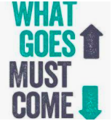
Negative Feedback Loops
Aid in self-regulation
Useful for maintaining an optimal state within specific boundaries
Very common in human body and life
Also known as feedback inhibition
Example: thermoregulation

Slide 5
Example: thermostat
Set thermostat to 20 degrees
→ temp drops below thermostat setting
→ sensor switches furnace ON
→ furnace produces heat
→ house warms up
Set thermostat to 20 degrees
→ temp increases above setting
TRY THIS ON YOUR OWN

Slide 6
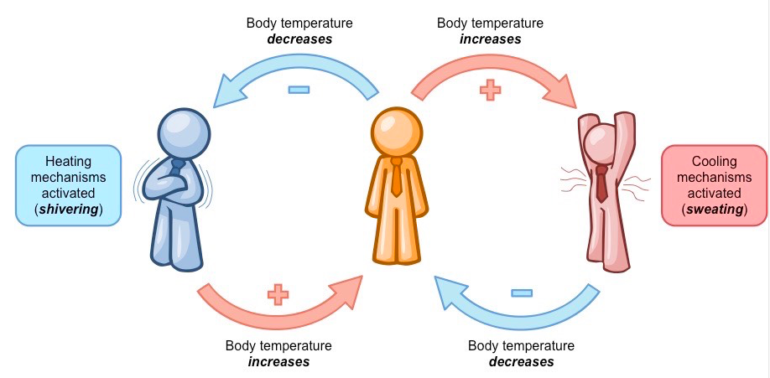
Example: thermoregulation
Let’s do this one together:
Body temp increases
Sensed by nerve cell
Activates cooling mechanism (sweating)
Body temp decreases
Sensed by nerve cell
Activates heating mechanism (shivering)
Body temp increases

Slide 7
Mix & Match
It is a blazing hot day in Mrs. Cote’s classroom. Match the following:
Body temp increases
Cooling mechanism (sweating)
Nerve cell
Body temp decreases
Effector
Response
Stimulus
Receptor
Extension: What would the control center be? Why do you think so?

Slide 8
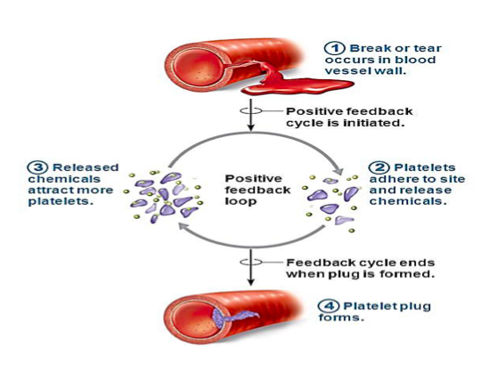
Positive Feedback Loops
increase the impact of a disturbance to the system
Not very common
Example: blood clotting

Slide 9
Example: blood clotting
You are so excited to get to Mrs. Cote’s class when you trip, fall and scrap your leg. You start bleeding, but a few minutes later you have stopped bleeding. Lets analyze the feedback loop that is in place.
Break/tear in blood vessel wall (when you fell)
Platelets go to site of injury and release chemicals
Released chemicals attract more platelets
Platelet block forms
Bleeding stops

