Slide 1
The Circulatory System
Outcome 21

Slide 2
What does it do?

Slide 3
Function of the Circulatory System
Function: the circulatory system transports gases, nutrients, and waste around our body.
How does it do this?
Heart → muscle that pumps blood
Blood vessels → tubes that carry the blood (capillaries, veins, arteries)
Blood → liquid and specialized cells to carry the gases, nutrients and waste

Slide 4
Blood Vessels - Arteries
Arteries – carry blood away from the heart
Strong, thick tubes with smooth and connective muscles to keep blood moving
Do not have valves
Extension: why do arteries need to be thick and strong?

Slide 5
Blood Vessels - Veins
Veins – tubes with valves that bring blood toward the heart
Walls of veins (like arteries) contain connective and smooth muscles push blood through veins
Have valves → one-way only
Extension: why do veins have valves but arteries do not?

Slide 6
4 Valves in the Heart
Pulmonary Valve → prevents backflow of blood from the pulmonary artery to right ventricle
Tricuspid Valve → prevents backflow of blood from right atrium to right ventricle
Aortic Valve → prevents backflow of blood from left ventricle to aorta
Mitral Valve → prevents backflow of blood from left atrium to left ventricle

Slide 7
Valves of the Heart
valves act to keep blood moving in the correct direction
prevent the back flow of blood
"lub dub”
lub - sound of mitral and tricuspid valves closing
dub - sound of the aortic and pulmonary valved closing
Extension: what would happen if there were no valves in the heart?

Slide 8
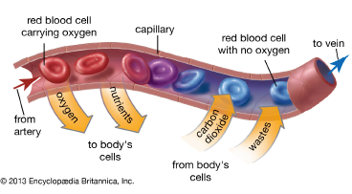
Blood Vessels - Capillaries
Capillaries – deliver oxygen and nutrients to the cells
Small, thin-walled tubes
Absorb waste (urea) and carbon dioxide
Transport wastes away from the cells
Extension: why do capillary walls need to be small and thin?

Slide 9
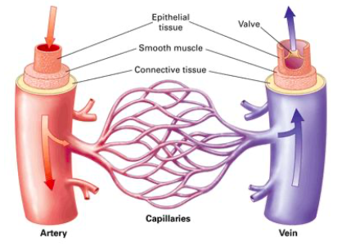
Arteries → Capillaries → Veins

Slide 10
The Heart
Approximately the size of a clenched fist
Beats an average of 72 times per minute
Protected by a sac of tissue called the pericardium
Two layers of epithelial and connective tissue that are on either side of a layer of muscle called the myocardium
Septum separates right and left side of the heart
Pulmonary circulation – circulates blood from the heart to the lungs
Systemic circulation - oxygen rich blood pumped from the heart to the body

Slide 11
Heartbeat
Contractions begin in a small group of cardiac muscle fibres called the sinoatrial node (SA node)
SA Node = pacemaker of the heart
Impulse spreads from SA node to the atria
Impulse picked up by atrioventricular node (AV Node)
Impulse is carried to a network of fibres in the ventricles → bundle of His
Rate of heartbeat (heart rate) depends on the body's need for oxygen
Need more oxygen → heart beats faster
Do not need more oxygen (homeostasis) → heart beats slower
Extension: do both the atrium and ventricles contract at once? Why or why not?
Extension: what effect would exercise have on your heart rate?

Slide 13
OP for Today
Complete the Parts of the Heart OP using your lesson notes and textbook pages 942-947
→ we will review this tomorrow
Watch the video (link on Weebly) on heartbeat and contraction.

