Slide 1
The respiratory system
Parts & Purpose
Outcome 22

Slide 2
What is the Respiratory System?
Respiration – the release of energy by combining oxygen with digested food (glucose)
Glucose (fuel) + oxygen → energy + water (waste) + carbon dioxide (waste)
Purpose → allows gas exchange of oxygen and carbon dioxide between the blood, air and tissue
Respiratory system → consists of the nose, mouth, pharynx, larynx, trachea, bronchi and lungs
Question: Does this equation look familiar? What is this process called?

Slide 3
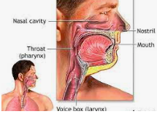
Parts of the Respiratory System
Nose & Mouth – air comes in through nose & mouth
Cilia and Mucus
air entering the respiratory system must be warmed, moistened, and filtered
large dust particles get trapped by the hairs lining the entrance to the nasal cavity
cilia sweep the trapped particles and mucus away from the lungs towards the pharynx

Slide 4
Pharynx – acts as a passage for both food and air
epiglottis covers the entrance to the trachea when you swallow → flap of tissue
air moves from pharynx into the trachea
Larynx – at the top of the trachea, contains two highly elastic folds of tissue called the vocal cords
muscles pull the vocal cords together
→ air moving between them causes the cords to vibrate
→ produces sound allowing you to speak

Slide 6
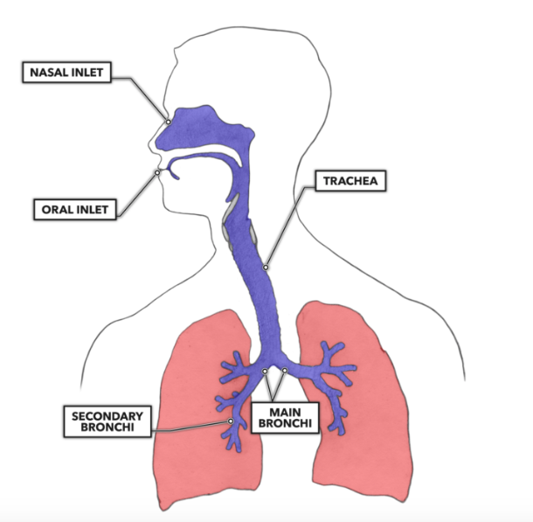
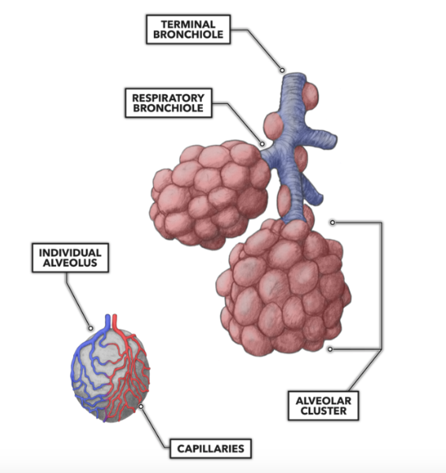
Trachea – from larynx air passes through trachea before dividing into the 2 bronchi
Bronchus (bronchi) – 2 branches from the trachea, each leading to a lung (one right, one left)
IN THE LUNG
Bronchioles – subdivided bronchi that continue to divide until reaching alveoli
Alveoli – air sacs that allow gas exchange between inhaled air and the blood
surrounded by a network of capillaries
grouped little clusters like grapes

Slide 7
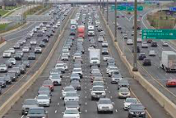
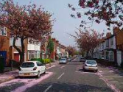
Life is a Highway . . . So is your Respiratory System
main highway = trachea
two-lane road = bronchus
street = bronchioles
driveway = alveoli

Slide 8
Inhale & Exhale
When you inhale
→ you breathe in oxygen
→ blood picks up oxygen from the alveoli
When you exhale
→ you breathe out carbon dioxide, waste, heat
→ alveoli pick up carbon dioxide from the blood
Extension: What would happen if you did not have alveoli?

Slide 9
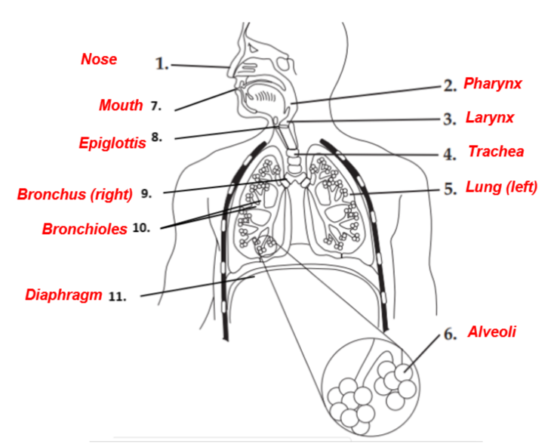
The Pathway of Air . . .
Air enters the body through the nose or mouth (inhale)
Air moves through the pharynx and into the trachea.
Trachea divides into two bronchi (connect to the lungs)
INSIDE the lungs, bronchi branch into bronchioles
At end of the smallest bronchioles are alveoli
Each alveoli is surrounded by capillaries

