Slide 1
The Digestive System
Outcome 24 & 25

Slide 2
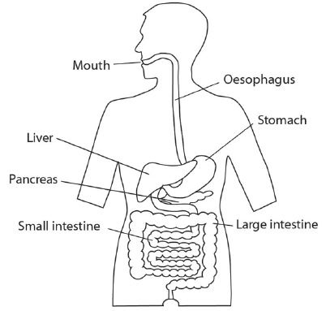
Purpose & Function
Function → to help convert foods into simpler molecules that can be absorbed and used by cells in the body
Your body cells convert the chemical energy stored in food into ATP
Includes → mouth, esophagus, stomach, small intestine, and large intestine.

Slide 3
Energy in Food
Energy in food can be measured by burning it → calories
Calories – the amount of heat required to raise 1g of water by 1*C
Fat → 9 calories per gram
Carbs & Proteins → 4 calories per gram
Food supplies the raw materials used to build and repair the body
make proteins that regulate cellular reactions
make phospholipids in cell membrane
make the DNA in your genetic material

Slide 4
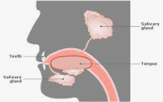
Mouth
Purpose → break down large food particles into smaller ones
Teeth → cut, tear and crush food
anchored in bones of the jaw
surface protected by mineralized enamel
Saliva → breaks down and moistens food for easier chewing
contains enzymes called amylase
amylase – breaks down carbs and starches into sugars

Slide 5
Esophagus & Stomach
Esophagus
Purpose → to push bolus (chewed up ball of food) down the throat into stomach
Food is moved along by contractions of smooth muscle – peristalsis
Sphincter closes the esophagus after food has passed into the stomach → prevents contents of stomach from moving back up the esophagus
Stomach
Purpose → a large muscular sac where digestion is continued
Exits stomach through the pyloric sphincter

Slide 6
Small Intestine
1. Duodenum
Purpose → digestion and absorption of the food you eat
Lined with villi → tiny finger-like projections to increase surface area
Almost all the digestive enzymes enters the small intestine
Amylase → break down starch
Trypsin → break down protein
Lipase → break down fat
Maltase, sucrase and lactase → break down carbohydrates further
Peptidase → break down protein further
Digestive fluid comes from the pancreas, liver, and lining of duodenum

Slide 7
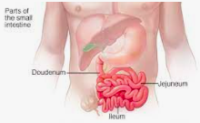
z
2. Jejunum & Ileum
Purpose → absorption of nutrients
Approx. 6m long
Most digestion is complete at this point
Most of digested proteins and carbs are absorbed into the capillaries (in villi)
Molecules of undigested fat and some fatty acids are absorbed by lymph vessels
There is very little enzymatic activity in your small intestine

Slide 8
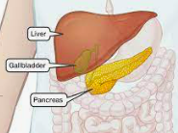
Pancreas
Behind the stomach
3 important functions
Produce hormones → regulate blood sugar levels (insulin)
Produces enzymes → break down CHO, proteins, lipids and nucleic acids
Produced sodium bicarbonate → neutralizes stomach acids

Slide 9
Liver
Just above and to the right of the stomach
Purpose → produces bile
Bile – a dissolving detergent that helps dissolve fat in fatty foods,
Stored in a small pouch like organ called a gallbladder
Does not contain enzymes
Breaks up large droplets of fat into smaller droplets

Slide 10
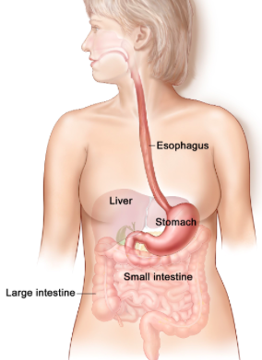
Large Intestine (Colon)
Purpose → to remove water from undigested food
Absorb water across the wall of the large intestine
Bacteria present in the large intestine produce compounds that the body can use (ex. vitamin K)
Extension: What would happen to these bacteria if you took large amounts of antibiotics?

